Slide 1

Hello Haven
Carlo Liquido, Parv Sondhi, Shrish Dhar

Slide 2
Most common mental illness in the country
70 Million US Adults
“ILLOGICAL”
1 in 5 American adults
No clear solution
ANXIETY
Minimum 6 months to get over
Fear of the Future
One in three actually receive treatment
Makes you feel LONELY

Slide 3

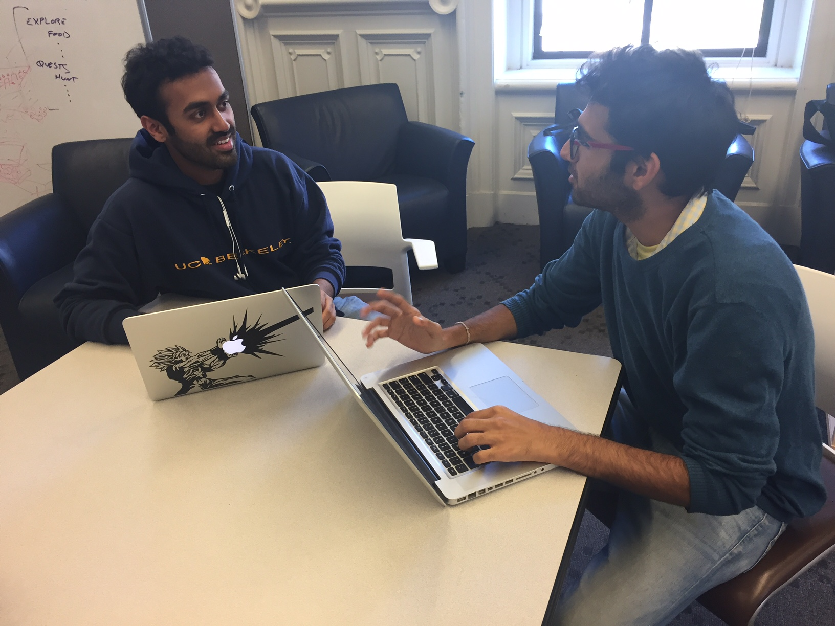
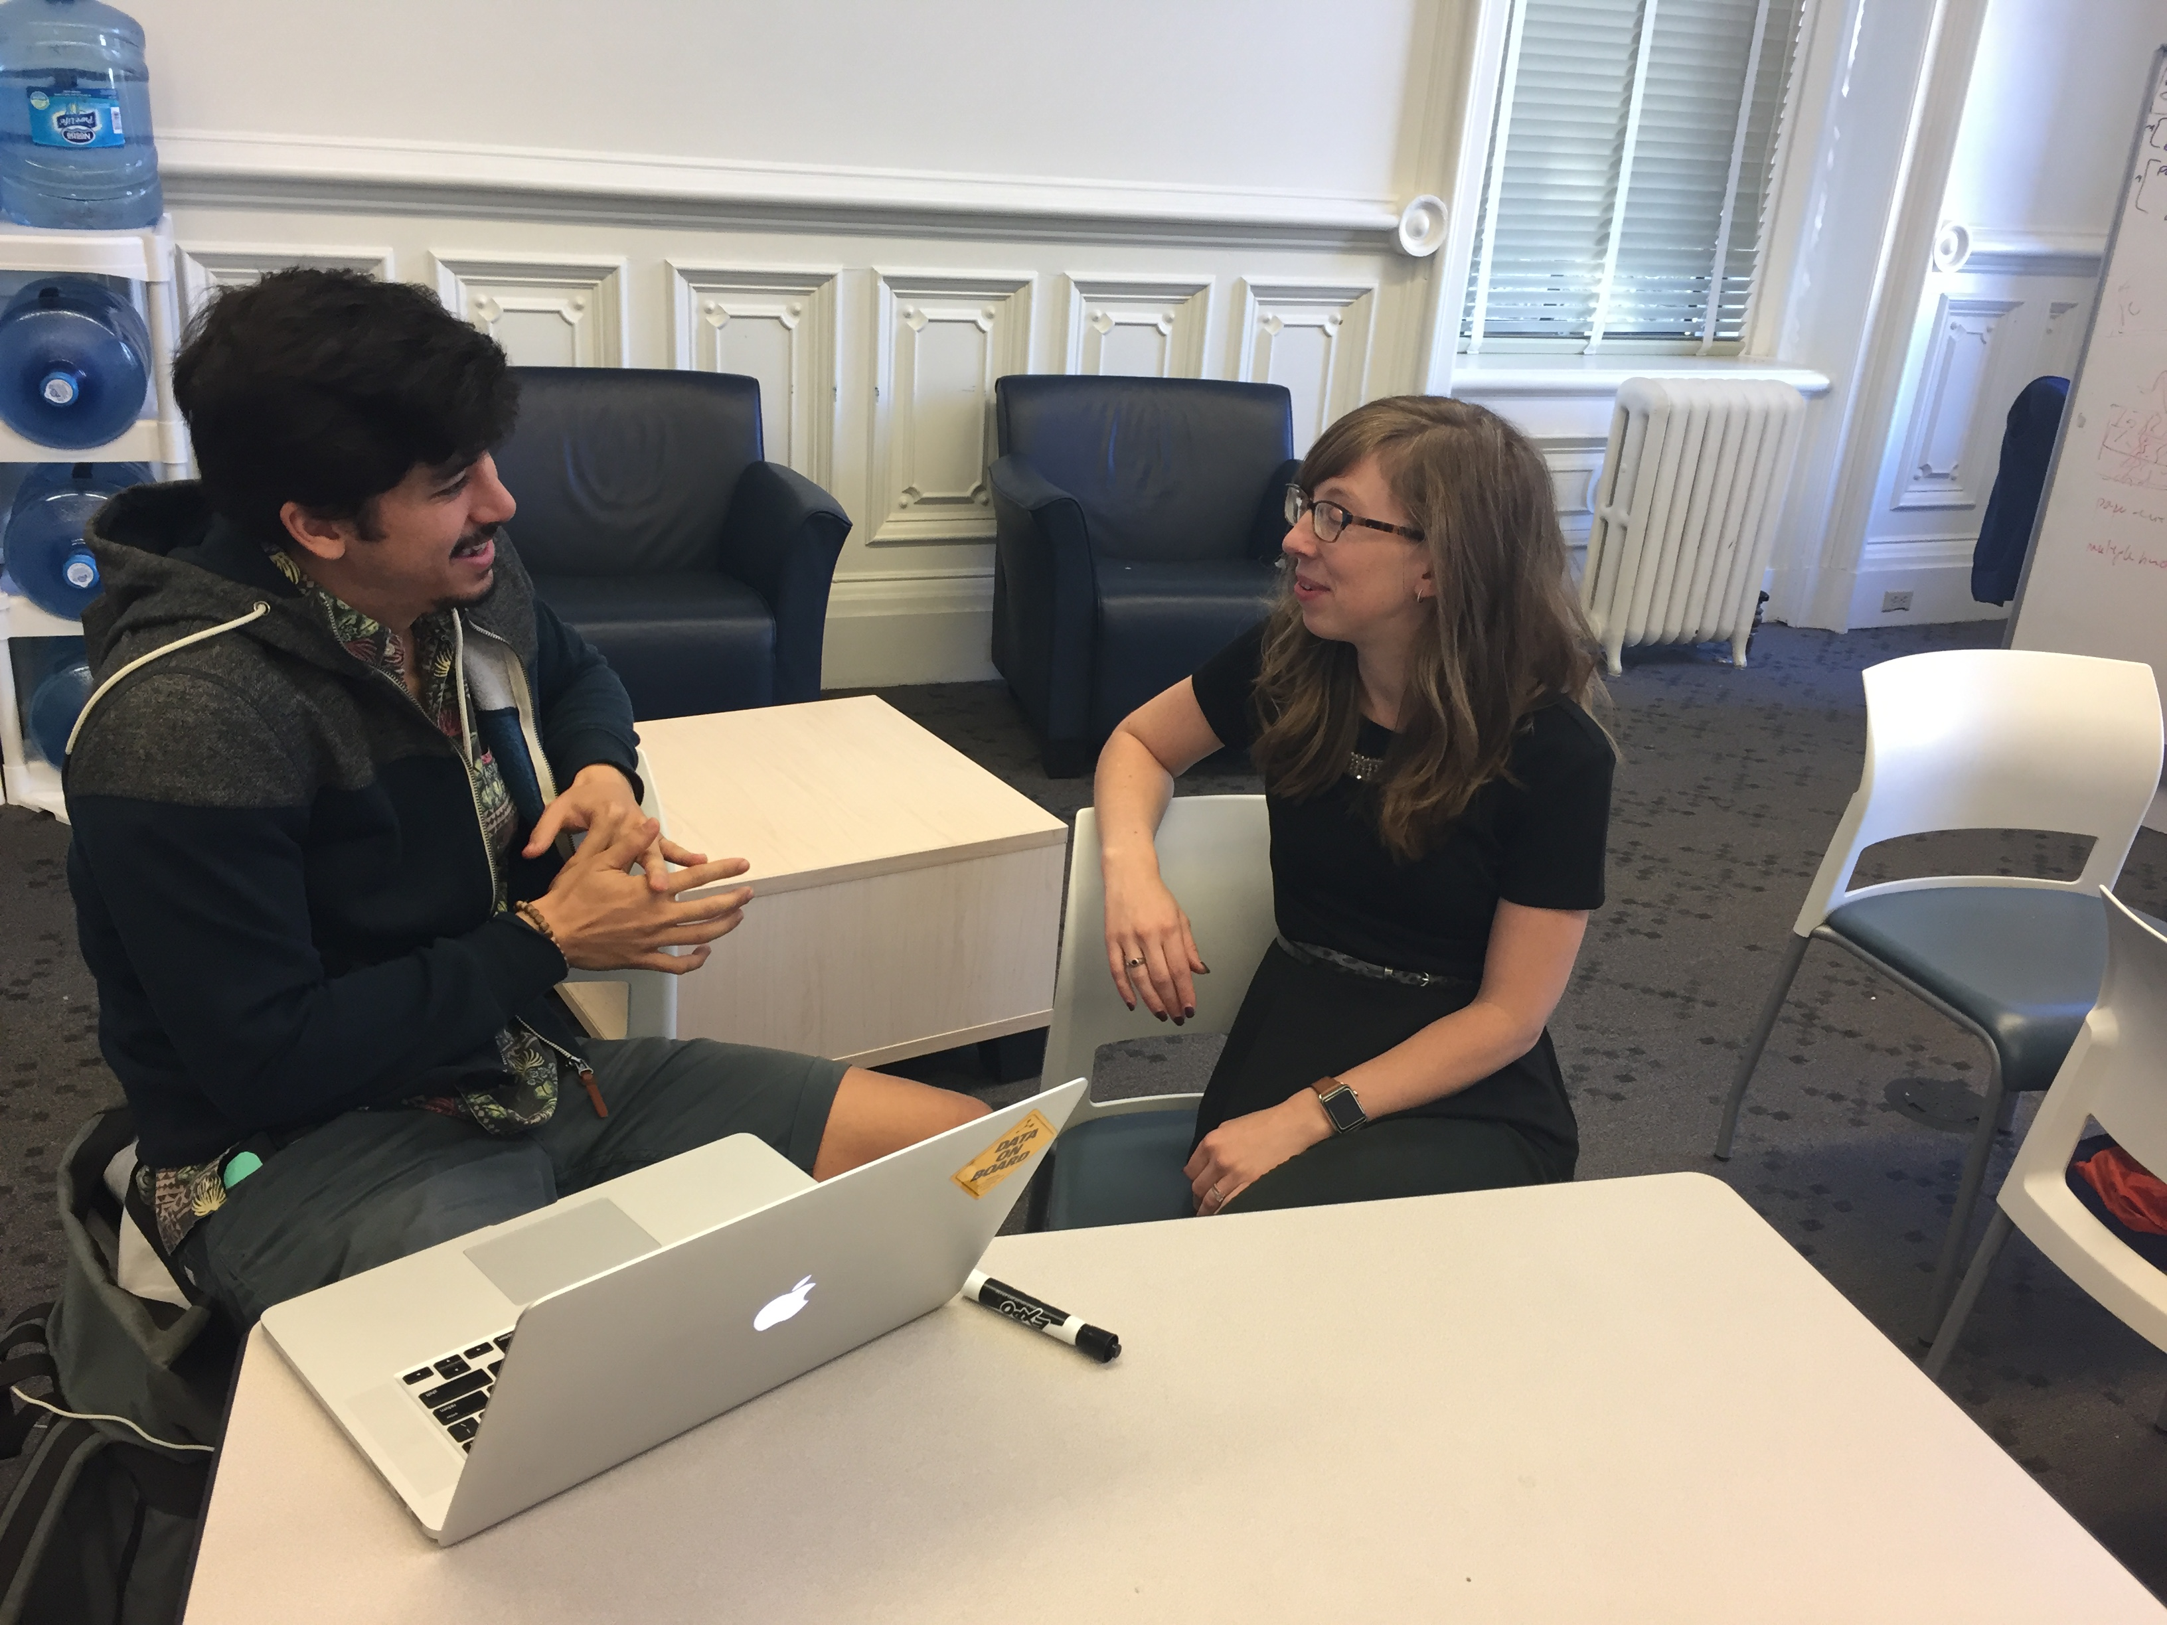
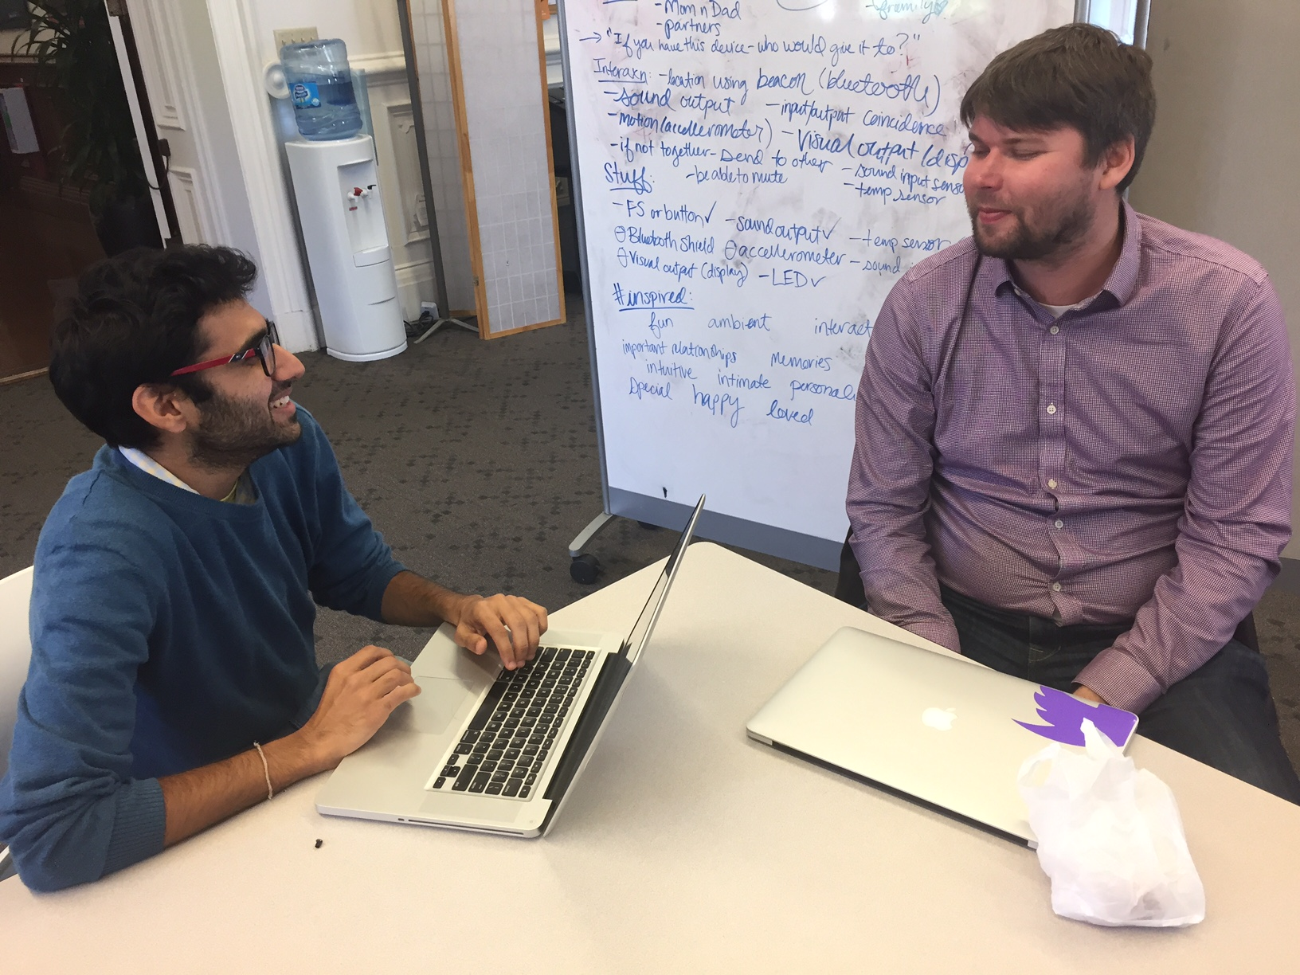
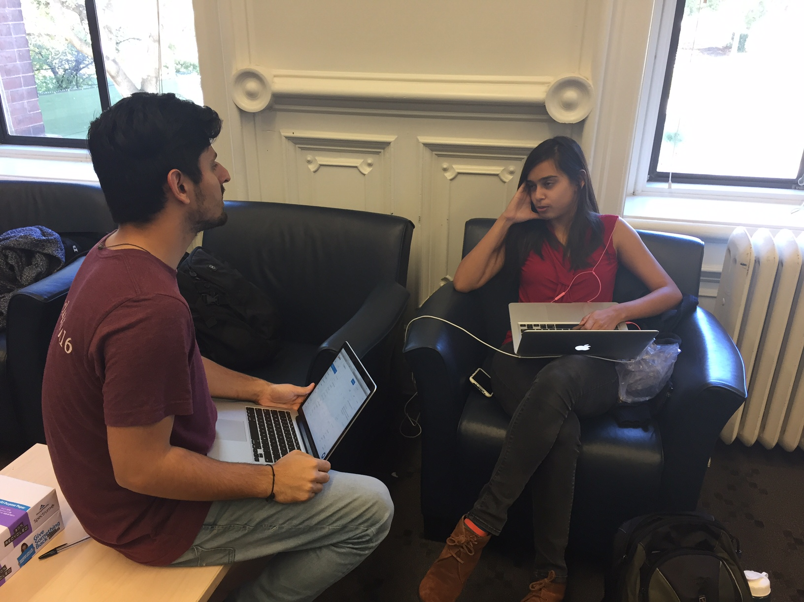
Our Process
14 Contextual Enquiries
Lo-fi Prototyping
12 Usability Tests
3 Secondary Personas
1 Primary Persona
Storyboarding
Customer Journey Mapping

Slide 4
The Protagonist is Anxiety, not Technology
“Truly” understanding Anxiety
Challenges
Analyzing how job search triggers anxiety
Measuring our impact on Anxiety

